Slide 1
Anapra Soar Day 12-08-2014
Bottom End of
Soarable Wind Speed
Window

Slide 2
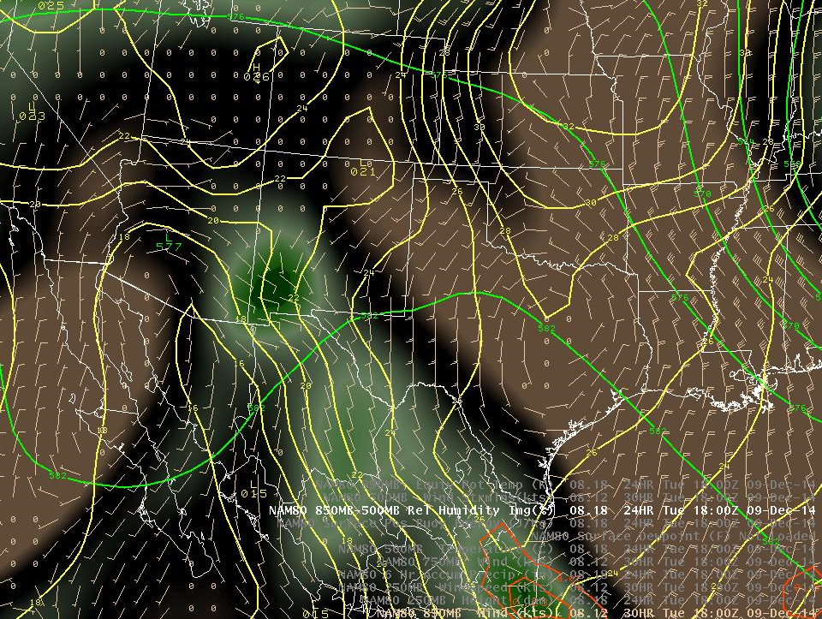
NAM Fcst @ 11AM Mon. Dec. 8, 2014

Slide 3
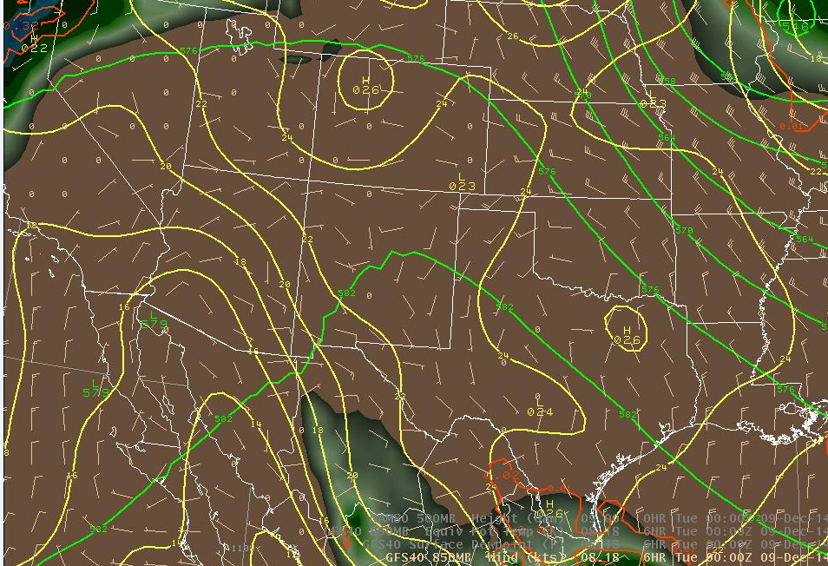
GFS Fcst @ 5 PM Mon. Dec. 8, 2014

Slide 4
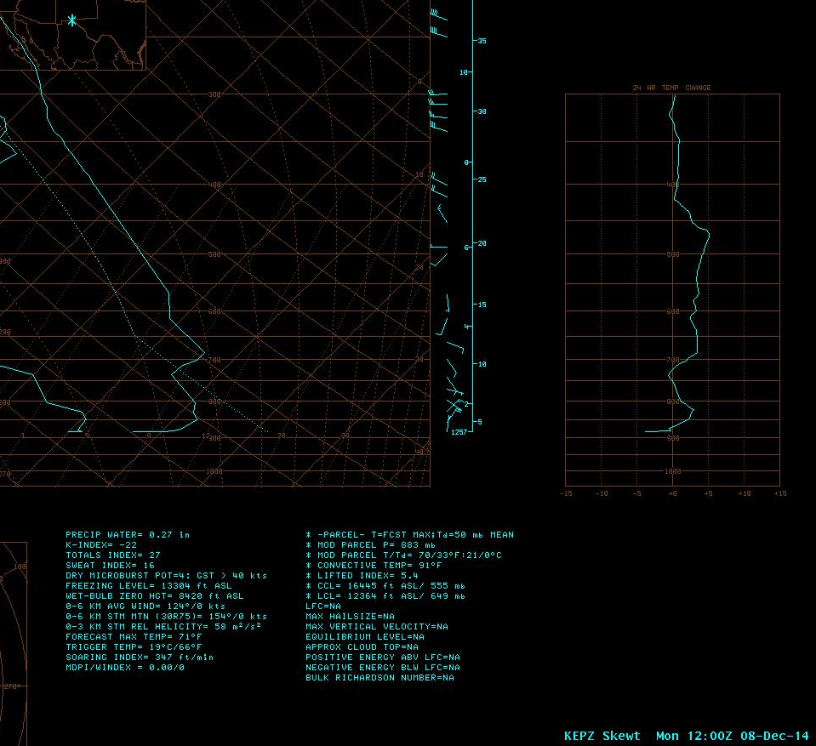
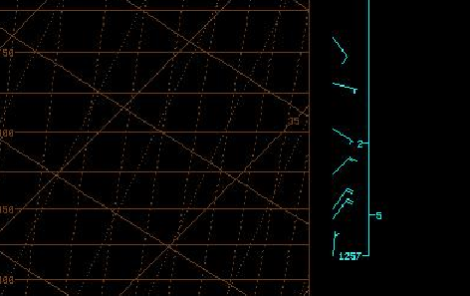
Actual Upper Air
Sounding
Mon 4 AM Dec. 8, 2014

Slide 5
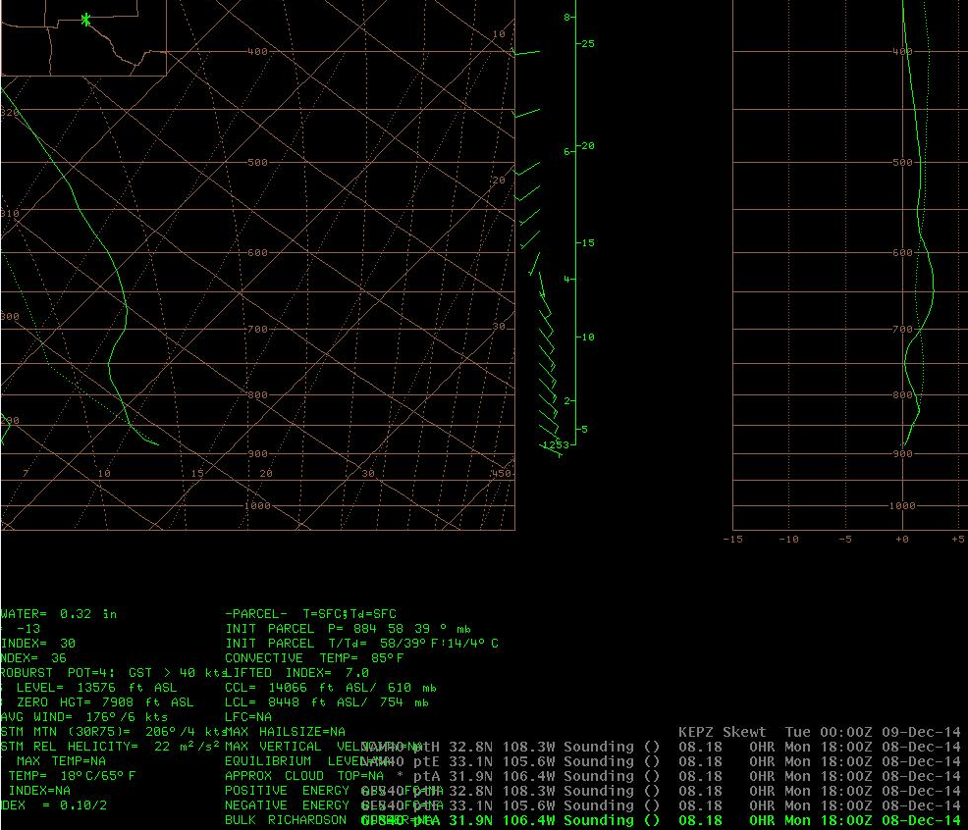
GFS Fcst @ 11AM
Mon. Dec. 8, 2014

Slide 6
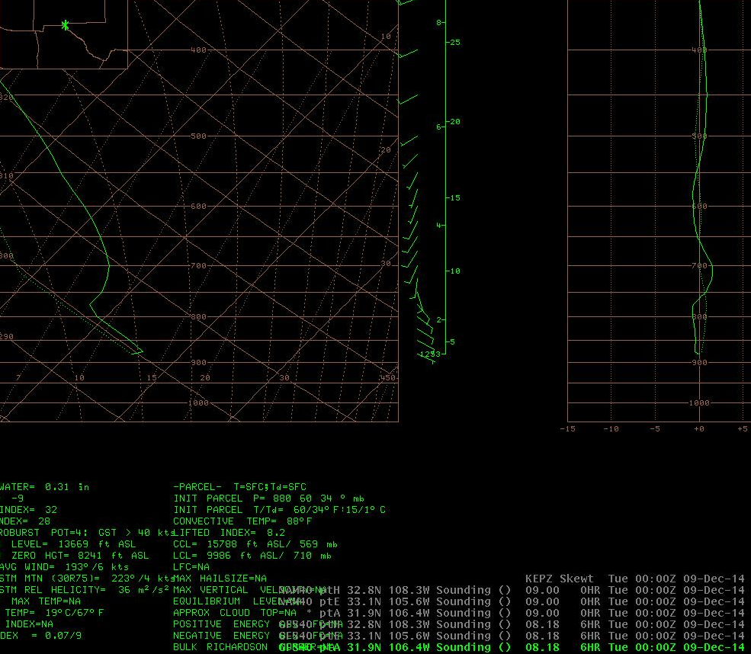
GFS Fcst @ 5PM
Mon. Dec. 8, 2014

Slide 7
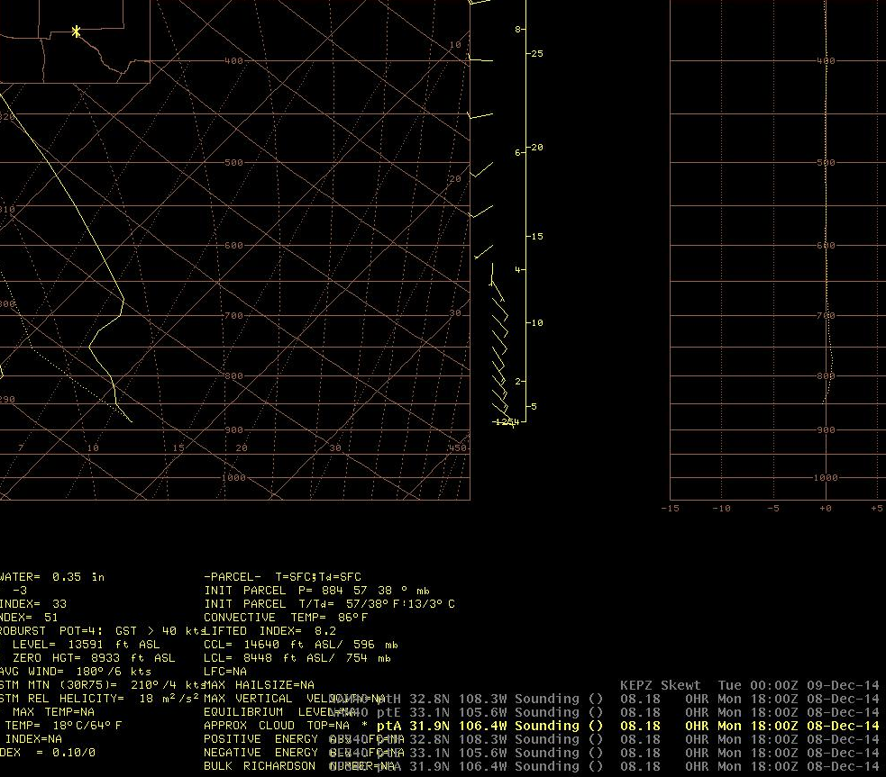
NAM Fcst @ 11AM
Mon. Dec. 8, 2014

Slide 8
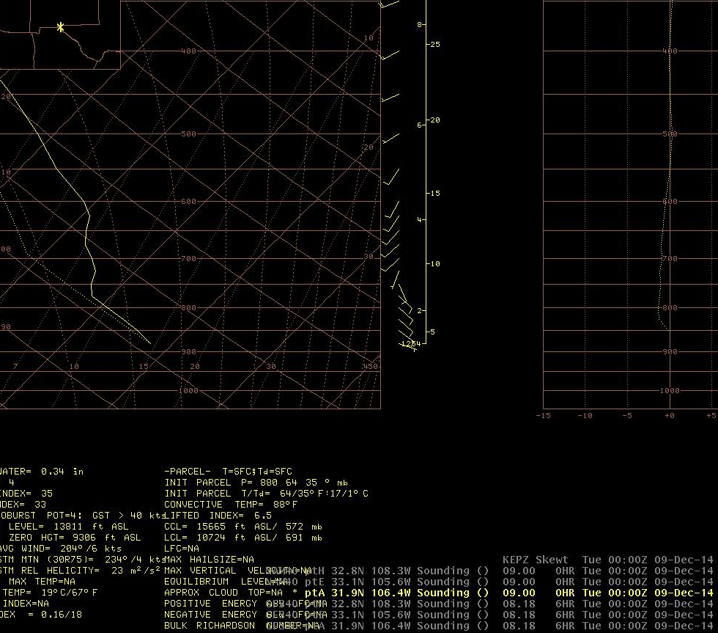
NAM Fcst @ 5PM
Mon. Dec. 8, 2014

Slide 9
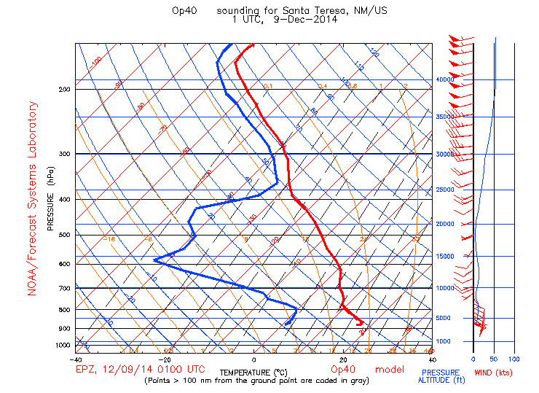
RAP model forecast sounding for Anapra Ridge @ 6PM

Slide 10
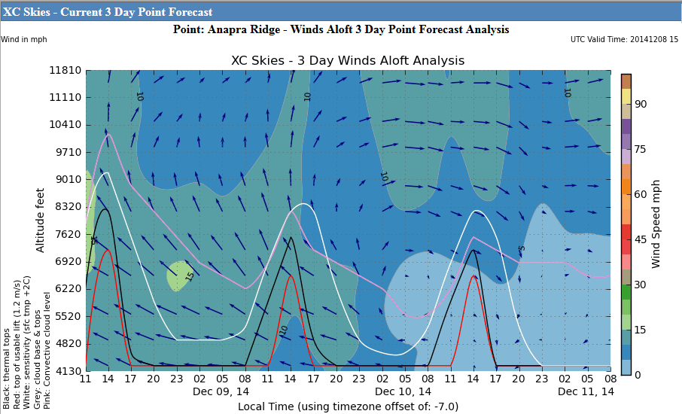
XC Skies Time-Series for Anapra Ridge

Slide 11
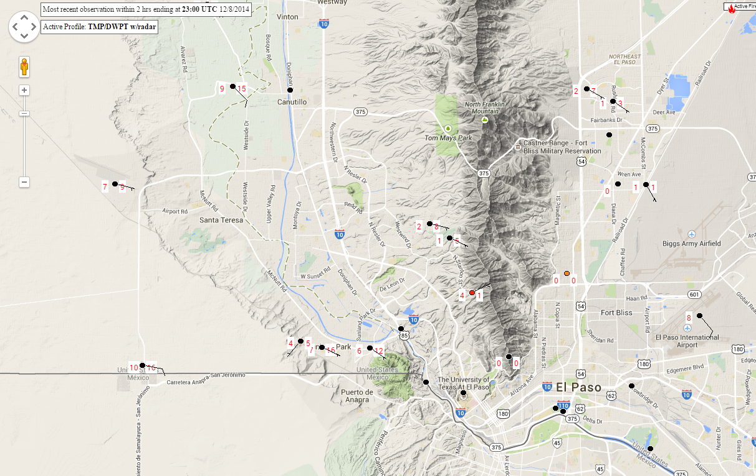
Mesowest observations plot for

Slide 12
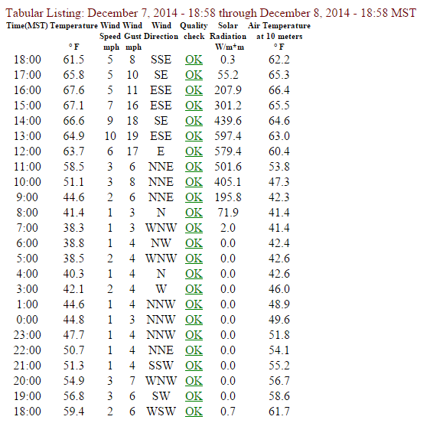
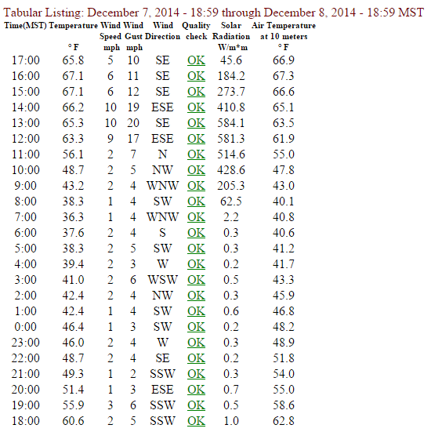
Desert View Observations Sunland Park Observations

Slide 13
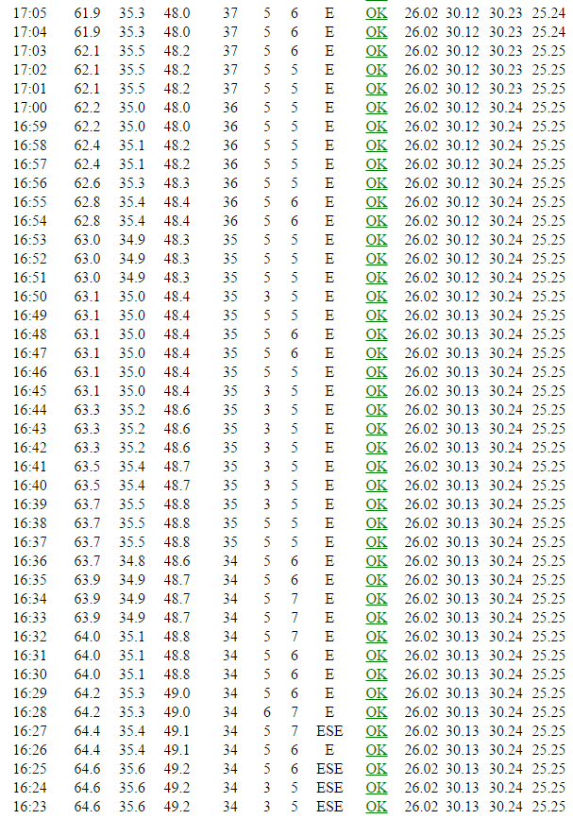
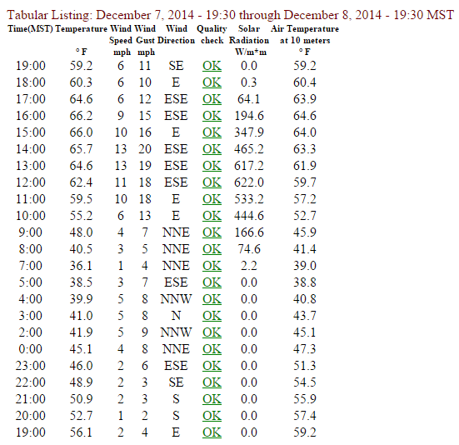
KEPZ Observations Santa Teresa Xing Observations

Slide 14
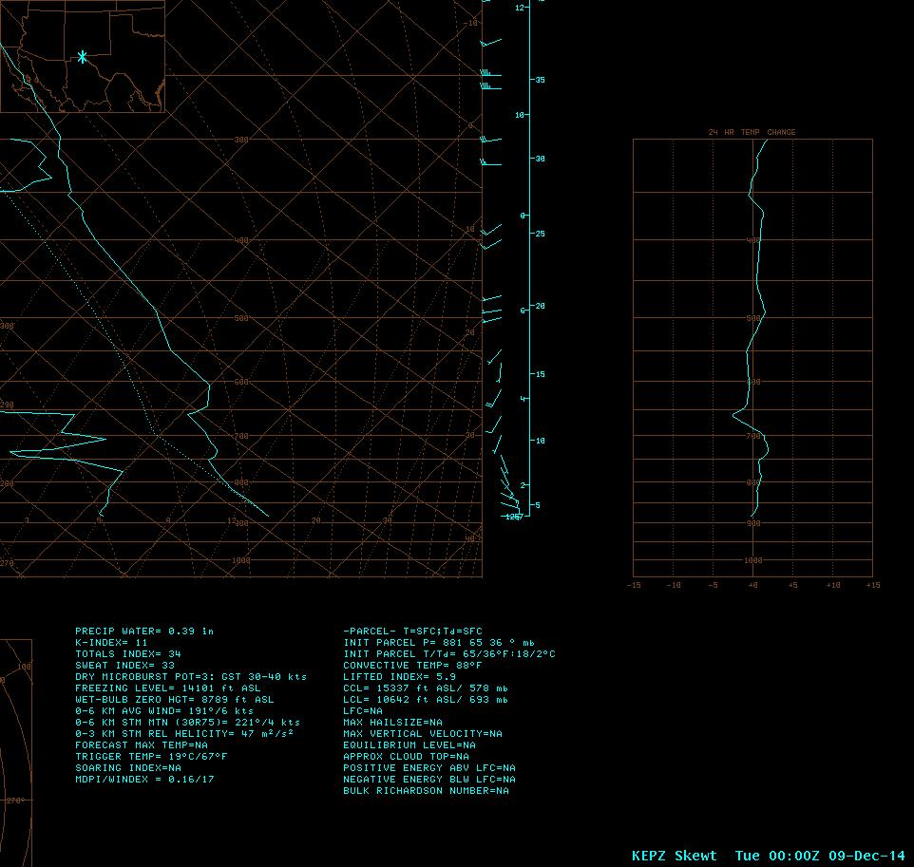
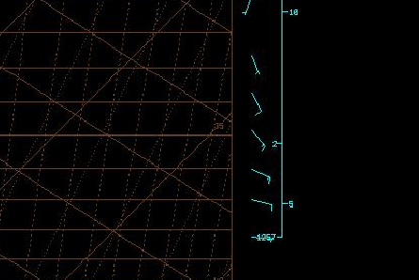
Actual Upper Air
Sounding
Mon 4 PM Dec. 8, 2014

